Slide 1




⚠ CLASSIFIED: THREAT INTELLIGENCE REPORT
LAN Attacks Analysis
Uncovering the Invisible War on Our Network
5 ATTACK TYPES
REAL LOGS Data Source
POWER BI Analysis Tool
Detected
PAGE 1

Slide 2
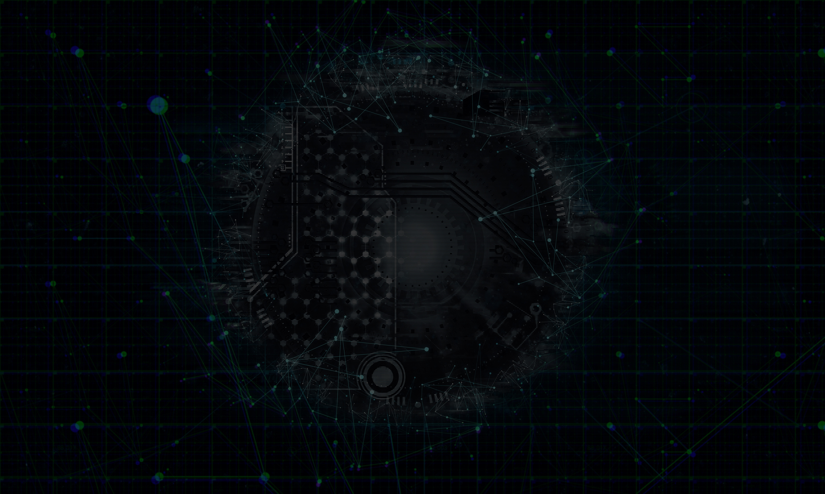

Developed By
Supervised By
Nouran Salah Mohamed Hussien Sultan
ENG . Ahmed Hany
Digital Egypt Pioneers Initiative (DEPI)
Data Analytics-Microsoft Power BI Specialist
PAGE 2

Slide 3
DATA SCOPE
"The analysis is based on cybersecurity event data containing attack types, protocols, ports, timestamps, geographic locations, severity levels, anomaly scores, and defensive response actions."
PAGE 3

Slide 4
🎯 PROJECT OBJECTIVE
🔹 Analyze LAN attack data to identify major cyber threat patterns and suspicious network behavior.
🔹 Understand when, where, and how attacks occur across the network environment.
🔹 Evaluate the effectiveness of Firewall and IPS systems in detecting and blocking threats.
🔹 Identify high-risk attack types, targeted services, and vulnerable network areas.
🔹 Generate actionable insights and recommendations to improve cybersecurity monitoring and defense strategies.
PAGE 4

Slide 5
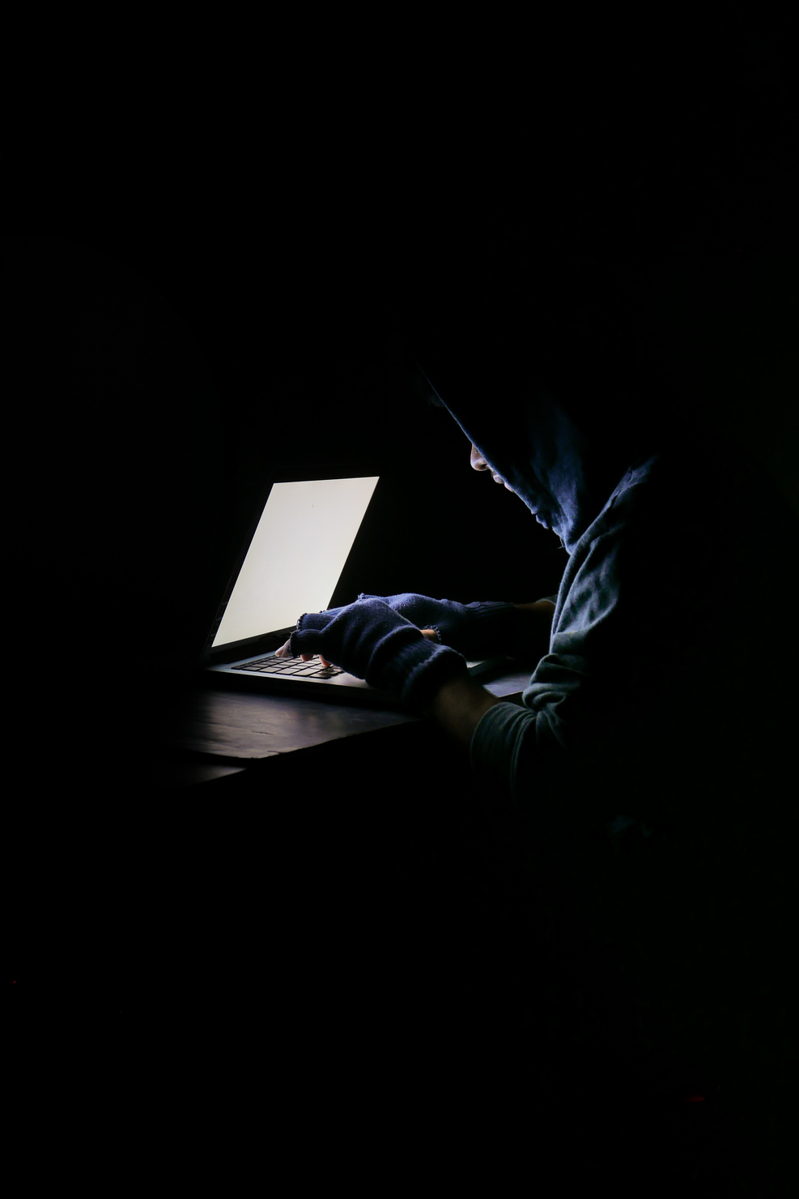
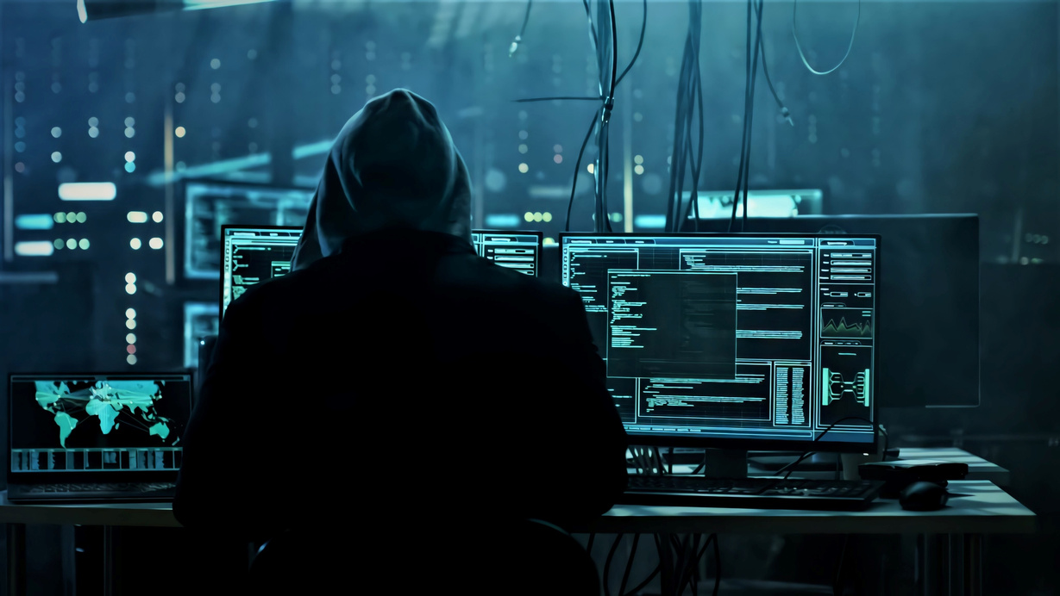
Project Overview
This project aims to analyze LAN attack activities in order to identify the most common cyber threats, understand attack behavior patterns, evaluate security response effectiveness, and generate actionable insights to improve network protection and threat monitoring
From (2020-2024).
PAGE 5

Slide 6

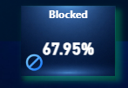
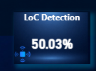
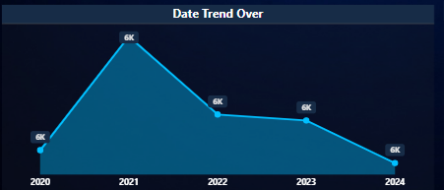
EXECUTIVE OVERVIEW
The network experienced continuous security activity with over 28K events detected. while most threats were successfully blocked.
The overall trend remained stable, indicating persistent rather than seasonal threats the cybersecurity activity observed within the network from 2020 to 2024. The chart illustrates the total number of detected attacks
Overall, the data reflects a persistent and evolving threat landscape, where reconnaissance and early-stage attacks play a major role in shaping subsequent security incidents.
PAGE 6

Slide 7
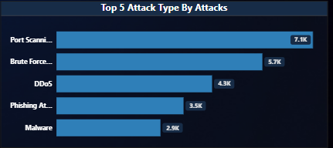
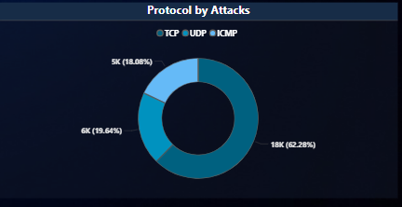
ATTACK ANALYSIS
"The threat landscape is heavily concentrated in a few attack families. Port scanning activity appears as the dominant behavior, followed by brute force attempts and DDoS attacks, indicating persistent reconnaissance and intrusion attempts."
PAGE 7

Slide 8
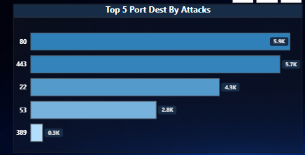
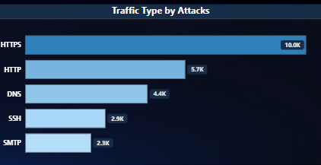
PORTS & PROTOCOL ANALYSIS
"ATTACK ACTIVITY IS MAINLY FOCUSED ON CRITICAL SERVICE PORTS RELATED TO WEB ACCESS, SECURE COMMUNICATION, AND REMOTE ACCESS. THIS HIGHLIGHTS WEB INFRASTRUCTURE AS THE PRIMARY EXPOSURE AREA."
PAGE 8

Slide 9
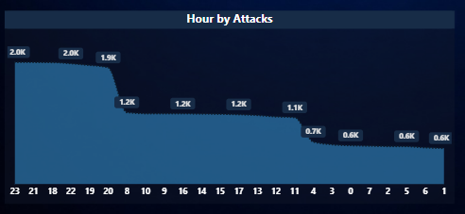
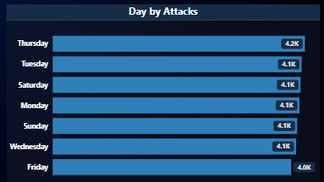
TIME-BASED ATTACK ANALYSIS
"Threat activity significantly increases during evening hours, especially near midnight. This suggests attackers may target periods of lower operational attention."
PAGE 9

Slide 10
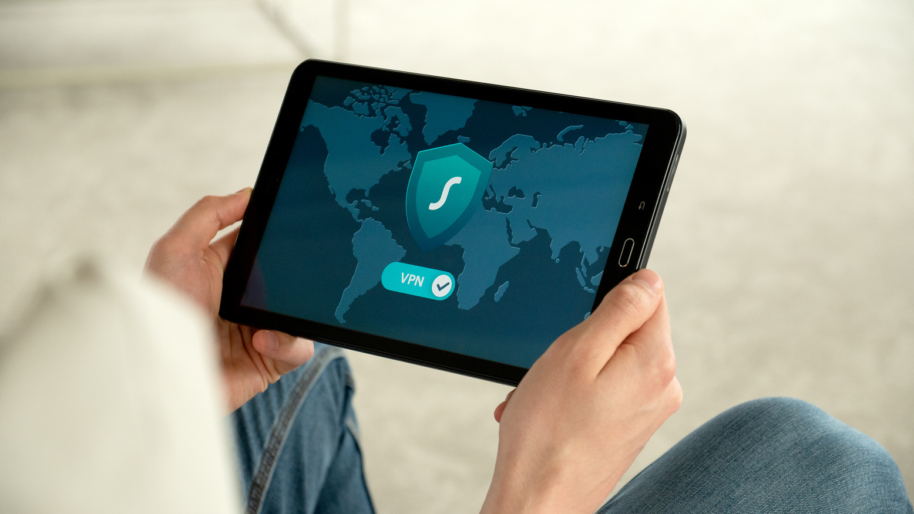

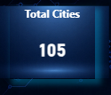
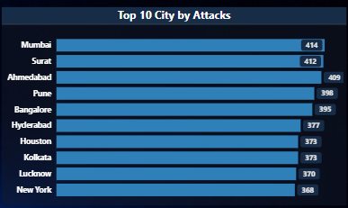
GEOGRAPHIC
"The attack sources are globally distributed rather than concentrated in one region, indicating diverse and international threat exposure."
PAGE 10

Slide 11
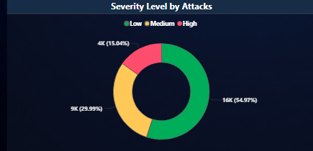
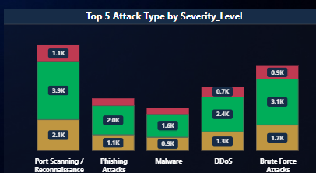
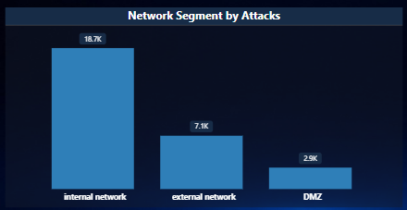
Risk & Severity Analysis
"Although most events are categorized as low or medium severity, repeated attack frequency creates significant operational risk and increases the likelihood of future compromise attempts."
PAGE 11

Slide 12
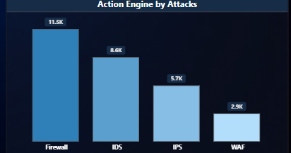
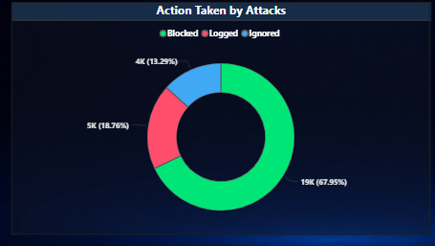
DETECTION & RESPONSE ANALYSIS
"The firewall represents the primary defense layer across the environment. However, ignored events highlight potential blind spots that may require further rule tuning and monitoring improvements."
PAGE 12

Slide 13
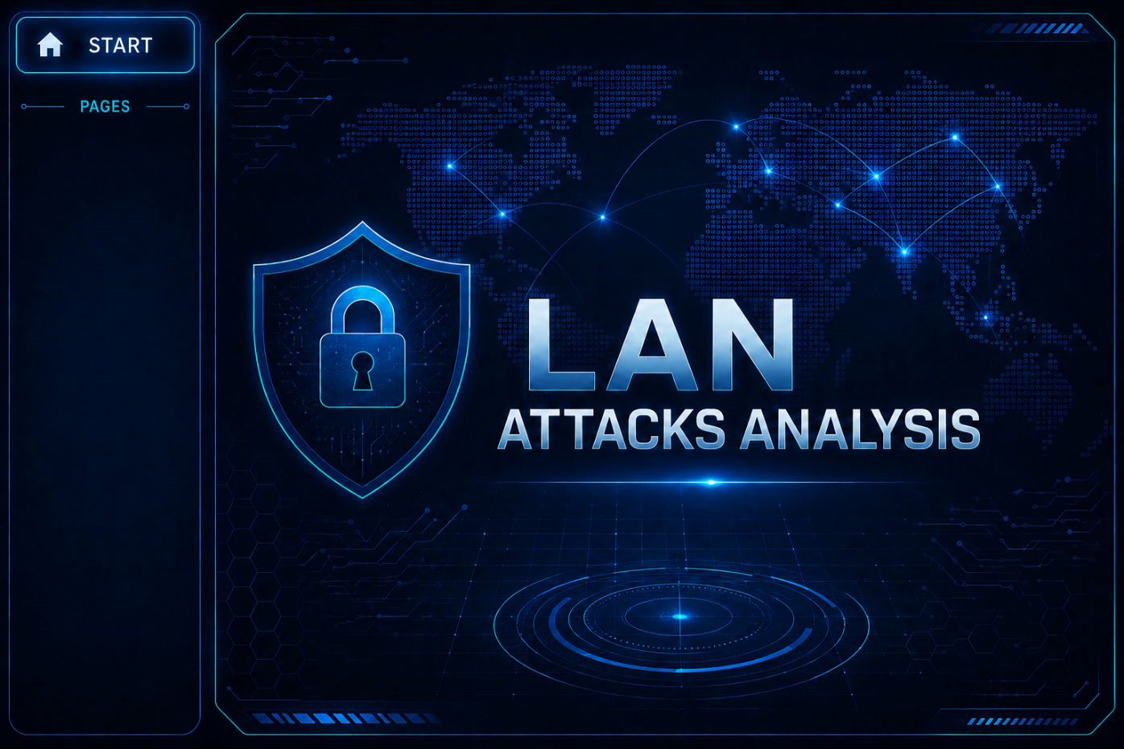


PAGE 13

Slide 14
KEY FINDINGS
Threats are highly concentrated in a few attack categories
Web services are the primary attack target
Evening hours show the highest threat activity
Global traffic sources increase exposure complexity
Firewall protection is strong but visibility gaps still exist
PAGE 14

Slide 15
RECOMMENDS
1. Enhance Monitoring
2. Improve Early Threat Detection
3. Strengthen Protection
4. Network Segmentation
5. Incident Response Plan
PAGE 15

Slide 16
CONCLUSION
"The analysis demonstrates that LAN threats are continuous, concentrated, and operationally significant. By improving visibility, strengthening protection around critical services, and enhancing early detection capabilities, organizations can significantly reduce network exposure and improve cybersecurity readiness."
PAGE 16

Slide 17
THANKS
1.
DIGITAL EGYPT PIONEERS INITIATIVE (DEPI)
2.
COLLABORATORS & MENTORS
3.
SPECIAL THANKS
Special thanks to the Digital Egypt Pioneers Initiative for equipping us with industry-focused knowledge and practical experience in data analytics and digital technologies.
I would like to express my heartfelt appreciation to all mentors, instructors, and supporting teams whose guidance and expertise played a significant role in the success of this project.
Technical Training: CLS
Coaching Partner: Freelance Yard
English Training: Berlitz
Freelance Instructor: Eng. Ahmed Hasanein
Deep appreciation to our doctor for the exceptional mentorship and insightful guidance throughout this journey.
PAGE 17

Slide 18
Thank You
GIT HUB
Nouran Salah Mohamed Hussien Sultan
nouranelqolob
PAGE 18

